Slide 1
Components In Next Js

Slide 2

Introduction to Next.js Components
Next.js is a powerful React framework that enables server-side rendering and static site generation.
Components are the building blocks of Next.js applications, allowing for modular code and reusable UI elements.
Understanding components is essential for creating efficient and maintainable applications with Next.js.
Notes:
Image source: https://makerkit.dev/blog/tutorials/next-server-components

Slide 3
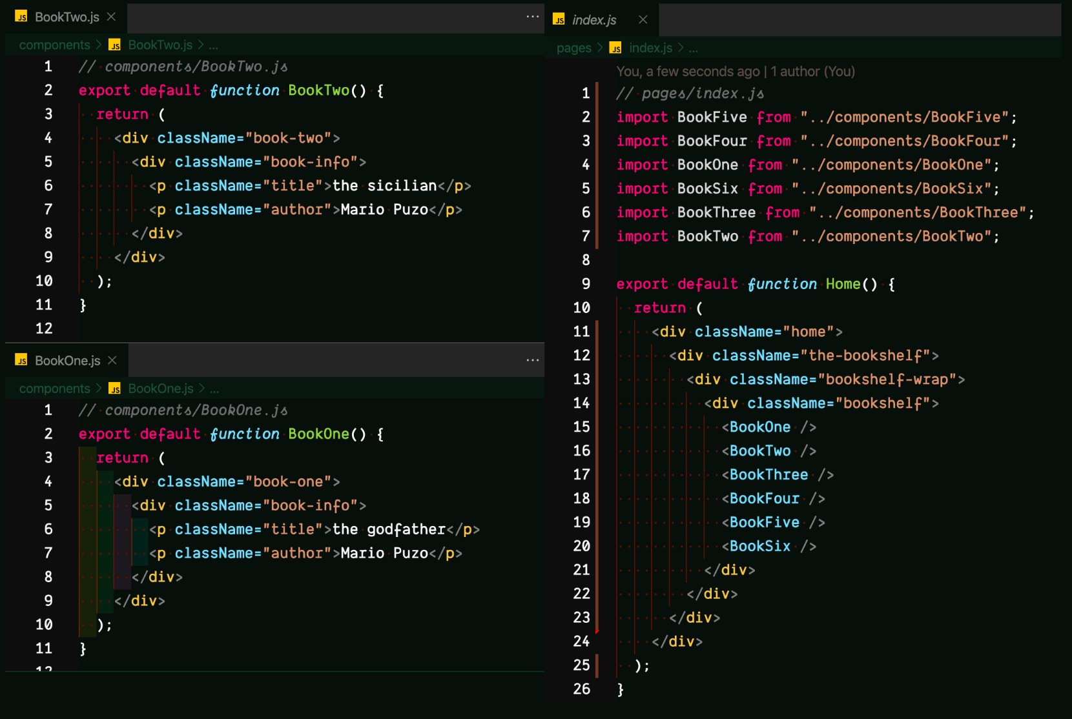
Components
Next.js primarily uses functional components, which are simpler and more concise than class components.
Components can be categorized into Presentational and Container components, each serving a unique purpose in the UI hierarchy.
Custom components can be created to encapsulate specific functionality and styling, enhancing code organization.
Notes:
Image source: https://dl-uk.apowersoft.com/en/next-js-typescript-material-ui-template.html

Slide 4
Types of Components in Next.js
const Button = ({ label }) => <button>{label}</button>;
class Welcome extends React.Component {
render() {
return <h1>Hello, {this.props.name}!</h1>;
}
}
There are two main types of components in Next.js: functional and class components.
Simple JavaScript functions that return JSX (UI elements).
Can handle state and lifecycle using hooks (e.g., useState, useEffect).
ES6 classes that extend from React.Component.
Have a render() method to return JSX, and manage state with this.state
Notes:
Image source: https://slides.com/rodrigoarriaran/next-js/fullscreen

Slide 5
References
Next.js Documentation: https://nextjs.org/docs
React Documentation: https://reactjs.org/docs/getting-started.html
MDN Web Docs on Components: https://developer.mozilla.org/en-US/docs/Learn/React/Components

